Slide 1

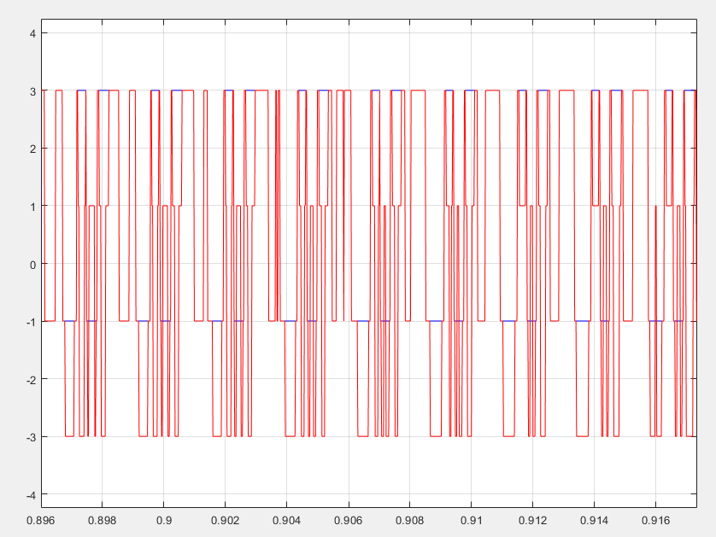
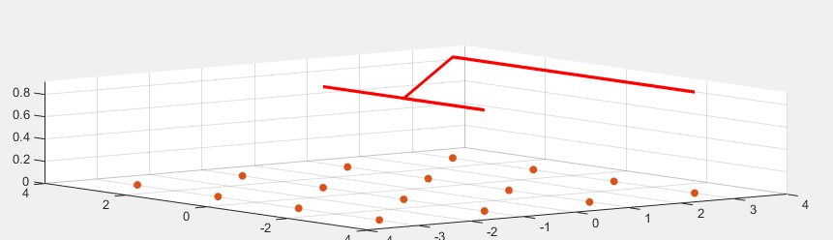
Real-Time Audio Equalizer with QAM Visualization with MATLAB
INPUT SIGNAL
QAM EQUALLIZED SIGNAL
-Learners Ground

Slide 2
OBJECTIVE
The objective of this project is to design and implement an interactive MATLAB application that simulates real-time audio playback while concurrently visualizing the audio signal as a Quadrature Amplitude Modulation (QAM) signal. The application aims to demonstrate how audio signals can be transformed into a QAM format and visualized dynamically, allowing users to observe the modulation process in both 2D and 3D QAM constellations.

Slide 3
Principle:
The principle of this application is to convert an audio signal into Quadrature Amplitude Modulation (QAM) for real-time visualization. The audio is modulated and displayed as dynamic QAM constellations in both 2D and 3D formats. Users can interact with the visualization by adjusting the modulation order and controlling playback, providing a hands-on learning experience.

Slide 4
BLOCK DIAGRAM:
Load and Preprocess Audio
QAM Signal Mapping
Real-Time Visualization
OUTPUT PLOT
Playback and Control

Slide 5
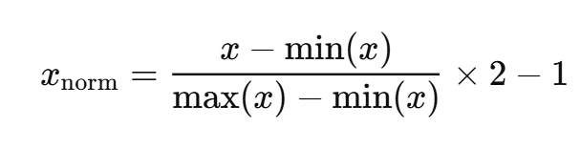
Normalization of Audio Signal:
The audio signal must fit the QAM modulation range, so it is normalized
x is the original audio signal.
x_{norm}​ is the normalized audio signal in the range of [-1, 1].

Slide 6

QAM Symbol Mapping
Convert the normalized audio signal into discrete values that correspond to QAM symbols in the constellation.
x_{mod​} is the mapped symbol in the range [0, M−1].

Slide 7
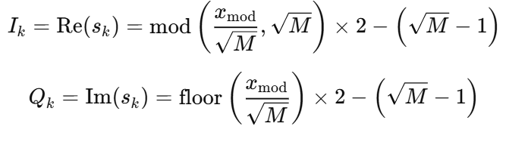
QAM Modulation
The QAM signal is formed by mapping the integers from the mapped signal x_{mod​} onto the corresponding points in the constellation.
In-Phase
Quadrature-Phase
s_{k​} is the QAM symbol.
I_{k}​ and Q_{k}​ represent the in-phase and quadrature components of the QAM symbol.
The values are scaled to ensure proper spacing in the constellation.

Slide 8

QAM Signal Generation
Once the symbol is mapped, the corresponding QAM signal can be generated in the time domain. This involves the generation of I and Q components as functions of time t:
f_{c}​ is the carrier frequency.
t is the time vector.

Slide 9

Time-Domain Waveform Visualization
The time-domain representation of the QAM signal is updated as the audio plays, showing the waveform for each QAM symbol.
A_{k}​ is the amplitude of the k-th symbol.
ϕ_{k}is the phase shift associated with the k-th symbol.

Slide 10
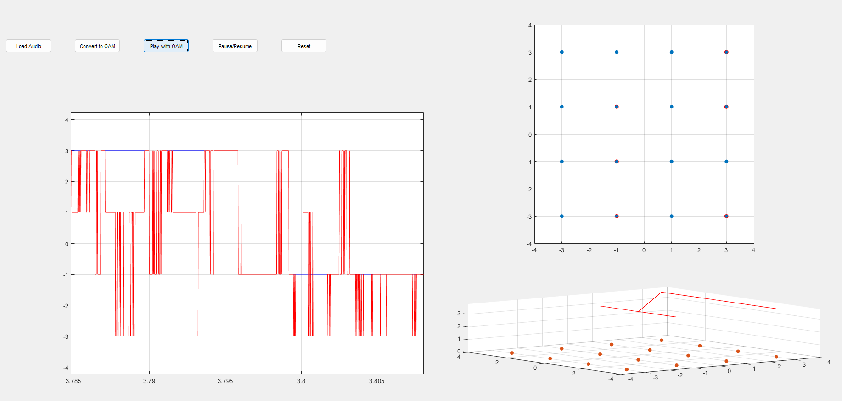
OUTPUT:

Slide 11
CONCLUSION
This project successfully demonstrates the real-time conversion of audio signals into Quadrature Amplitude Modulation (QAM) for visualization and analysis. By integrating audio signal processing with QAM modulation techniques, the application provides an interactive environment where users can explore how audio data can be mapped to digital modulation schemes. The real-time QAM visualization, including 2D and 3D constellations, allows users to observe the dynamic evolution of the signal during playback.

Slide 12
learnersground2@gmail.com
THANK YOU

